Slide 1
Digital Portfolio
STUDENT NAME: MONIKA L
REGISTER NO AND NMID: asunm293212402056
DEPARTMENT: BACHELOR OF COMPUTER APPLICATION
COLLEGE: VIDYA SAGAR WOMEN’S COLLEGE/ MADRAS UNIVERSITY

Slide 2
PROJECT TITLE
STUDENT PORTFOLIO…

Slide 3


AGENDA
Problem Statement
Project Overview
End Users
Tools and Technologies
Portfolio design and Layout
Features and Functionality
Results and Screenshots
Conclusion
Github Link
3/21/2024 Annual Review

Slide 4

PROBLEM STATEMENT
In This 20th century Where everyone one is being rush in there life with there works so should make it more easy for them and to save there time and energy we are now doing our Every Work in this digital platforms…

Slide 5

PROJECT OVERVIEW
IN TODAY’S COMPETITIVE WORLD IT HELPS TO ANALYSE MY ABILITY TO GAIN KNOWLEDGE AND TO ENHANCE MY CREATIVITY BY MY OWN PROJECT AND IT WILL BE A BIG STEPPING STONE FOR MY FUTURE…

Slide 6

WHO ARE THE END USERS?
“End users” are the people who ultimately use a product, service, or system.
In software development: the end users are the people who run and use the application (e.g., students using an e-learning app).
In education: students are the end users of learning materials and systems.

Slide 7

TOOLS AND TECHNIQUES
HTML: Structure of the web page.
CSS : Styling,layout,Colours,Fonts.
JAVASCRIPT : Smooth Scrolling Effect.
RESPONSIVE DESIGN BASICS:Sections, Navigation bar.

Slide 8
POTFOLIO DESIGN AND LAYOUT
About me: About myself and personal details
Projects: My works and completed projects.
Skills: My abilities and technical skills.
Contact: Ways to connect and communicate.
Responsive Layout: Works well on both mobile and desktop veiws.
8

Slide 9
FEATURES AND FUNCTIONALITY
Navigation bar with smooth Scrolling: Smooth accessing between sections.
Project Showcase: Presentation of projects with images and details.
Interactive elements: Effects and animations for better user experience.
Contact form with validation: It ensures correct input before submission.
Responsive design: Works well on all devices.

Slide 10
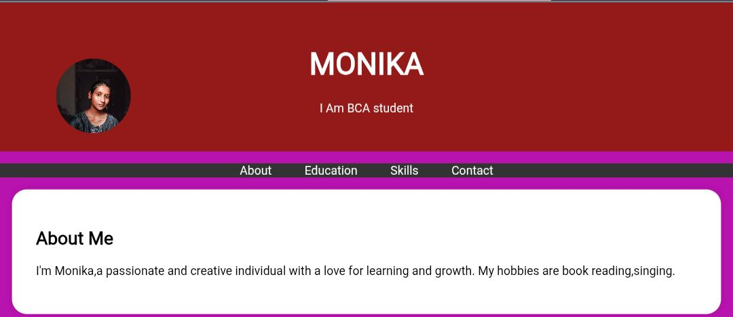

RESULTS AND SCREENSHOTS
3/21/2024 Annual Review
10

Slide 11
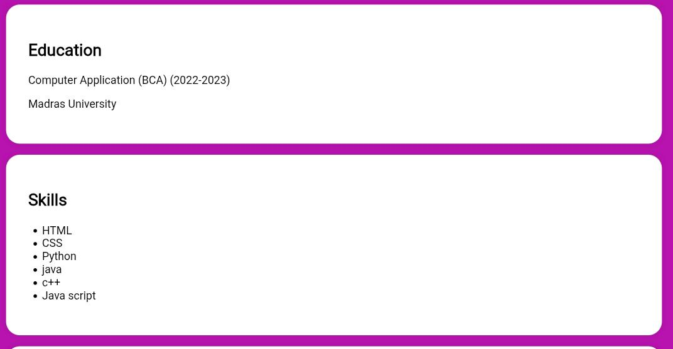

Slide 12
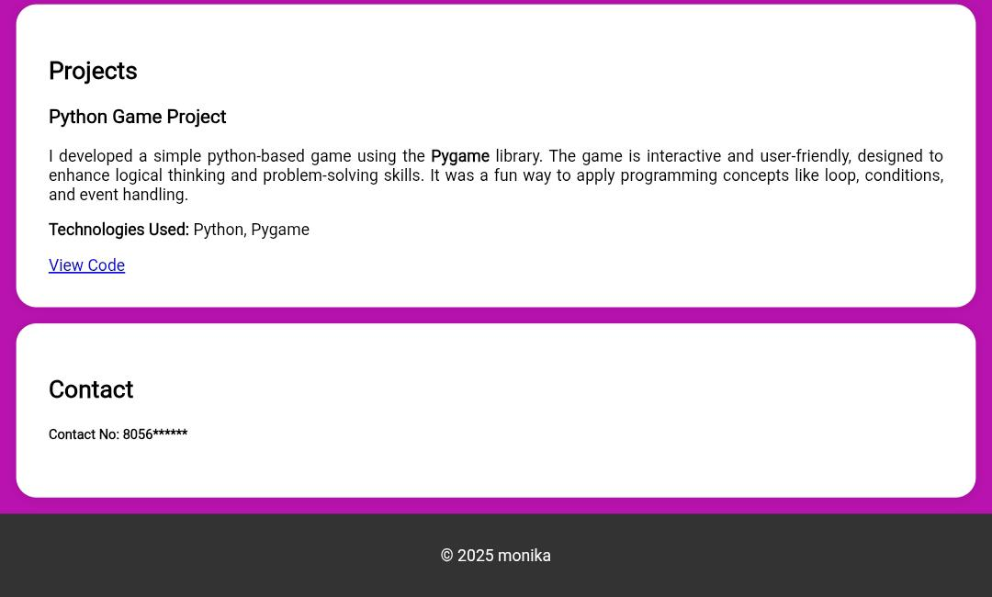

Slide 13
CONCLUSION
My portfolio highlights my journey as a BCA student with a strong interest in web development and programming. With skills in HTML, CSS, Python, Java, C++, Photoshop, and Canva, I aim to create meaningful and user-friendly digital solutions. I am passionate about continuous learning, exploring new technologies, and applying my creativity to build innovative projects. This portfolio reflects not just my academic path, but also my enthusiasm for growth and excellence in the IT field…
13

